Slide 1


Clustering

Slide 2
DISTANCE METRICS

Slide 3
DESIDERATA FOR PROXIMITY
If d1 is near d2, then d2 is near d1
If d1 is near d2 and d2 is near d3, then d1 is not far from d3
No document is closer to d than d itself

Slide 4
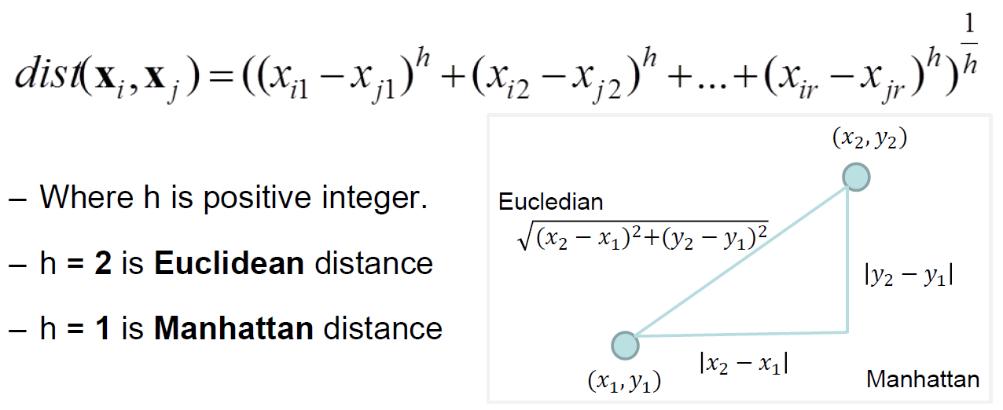
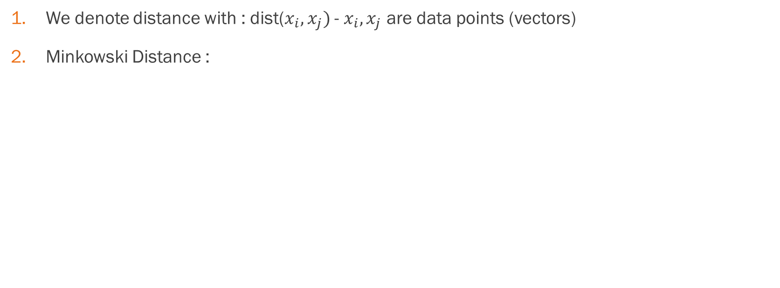
Distance for numeric attributes
We denote distance with : dist($x_{i},x_{j})$ - $x_{i},x_{j}$ are data points (vectors)
Minkowski Distance :

Slide 5
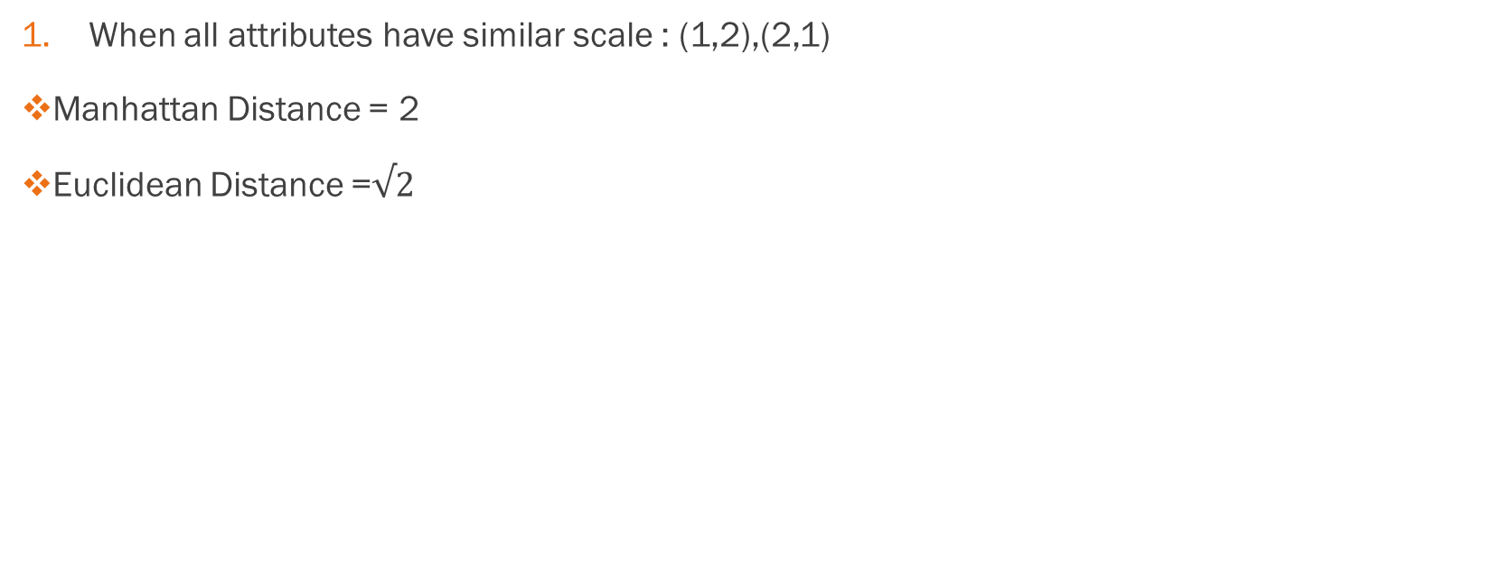
When to choose what?
When all attributes have similar scale : (1,2),(2,1)
Manhattan Distance = 2
Euclidean Distance =$√2$

Slide 6
Choosing the distance metric
When attributes have different ranges (10,100),(50,500)
Manhattan = 440
Euclidean = 401.99
2. Manhattan is more stable than Euclidean and scaling is better
-Scaling is better

Slide 7
Squared Euclidean and Chebyshev Distance
Squared Euclidean Distance : Place greater weight on data points that are further apart
Chebyshev Distance: Two data points are different if they differ on any one of the attributes

Slide 8
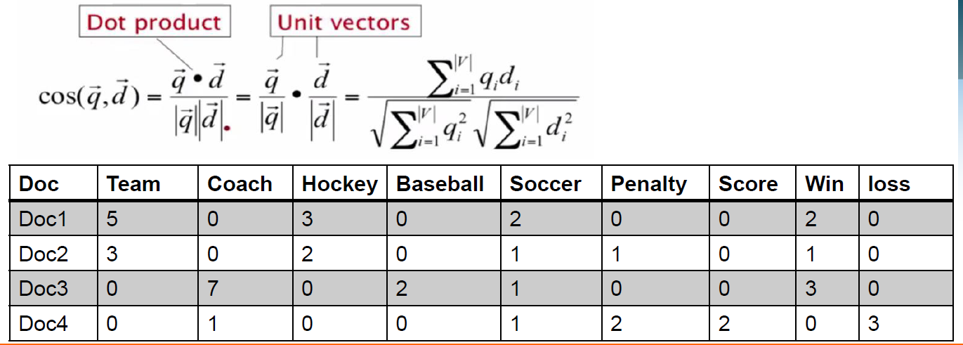
More Metrics
Weighted Squares : A particular attribute may be a lot more important than other attributes
Text: Cosine Similarity

Slide 9
Distance functions for Binary and Nominal attributes
We use a confusion matrix to introduce the distance functions/measures

Slide 10
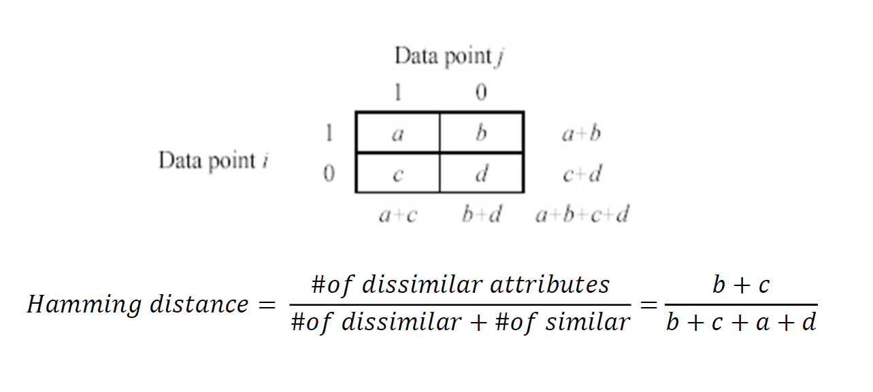
Confusion Matrix

Slide 11
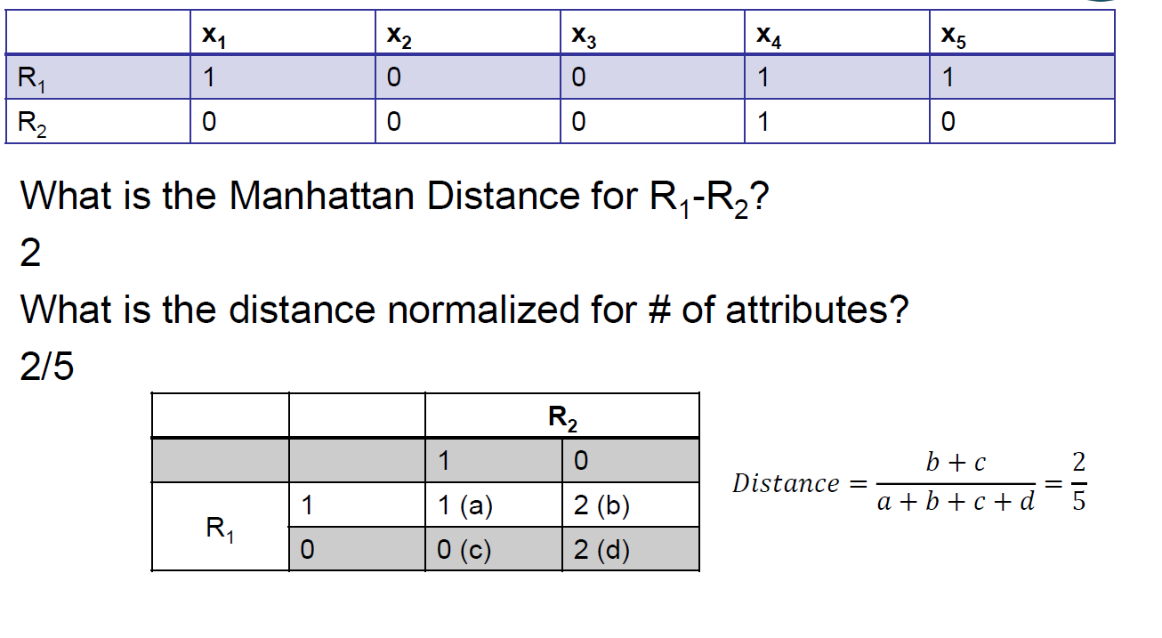

Slide 12
Symmetric binary attributes
A binary attribute is symmetric if both of its states (0 and 1) have equal importance, and carry the
same weights. For example , male and female of the attribute Gender

Slide 13
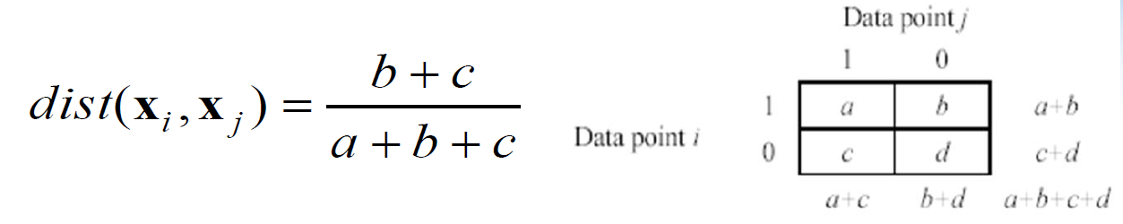
Asymmetric binary attributes
Asymmetric : if one of the states is more important or more valuable than the other
By convention, state 1 represents the more important state, which is typically the rare or infrequent state
Jaccard Coefficient is a popular measure
We can add some variations, adding weights

Slide 14
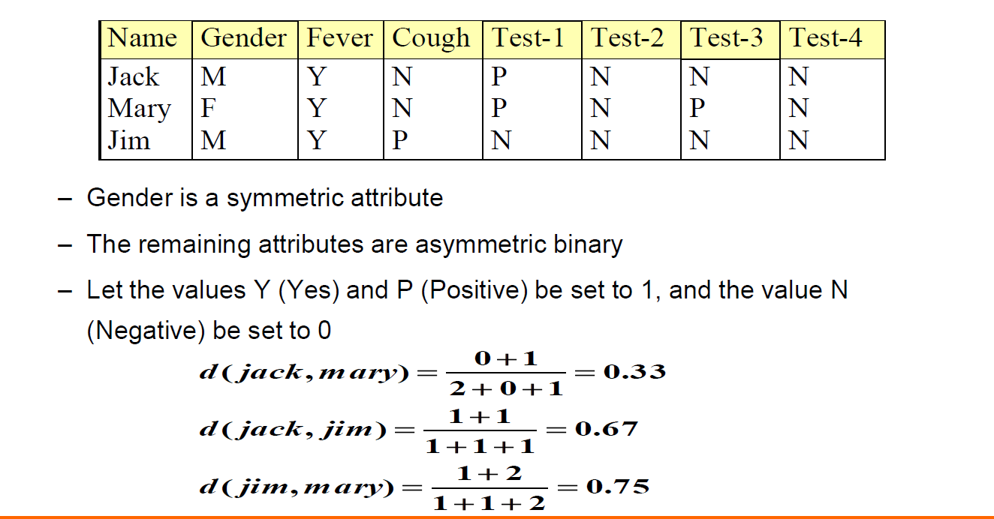
Dissimilarity between Binary Variables

Slide 15
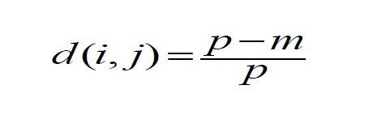
Categorical variables with multiple levels
A generalization of the binary variable in that it can take more than 2 states. E.g., red, yellow, blue, green
Method 1: Simple Matching
-m : # of matches , p: total # of variables
Method 2: Use a large number of Binary Variables
- Creating a new binary variable for each of the M nominal states

Slide 16
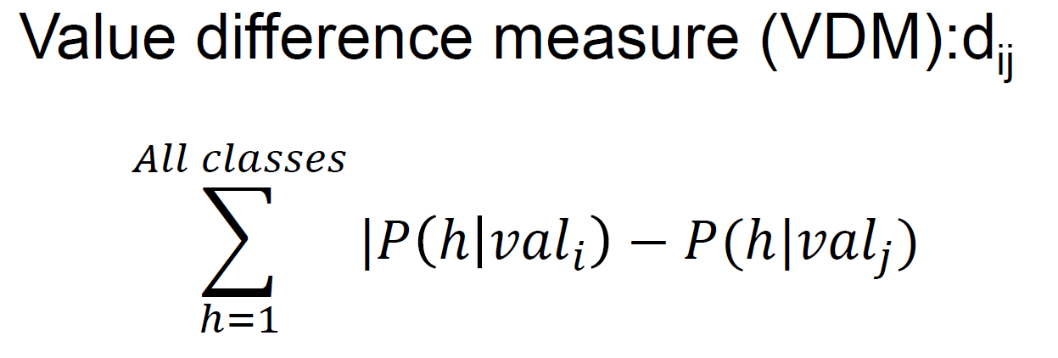
Another distance metric used in Supervised Learning

Slide 17
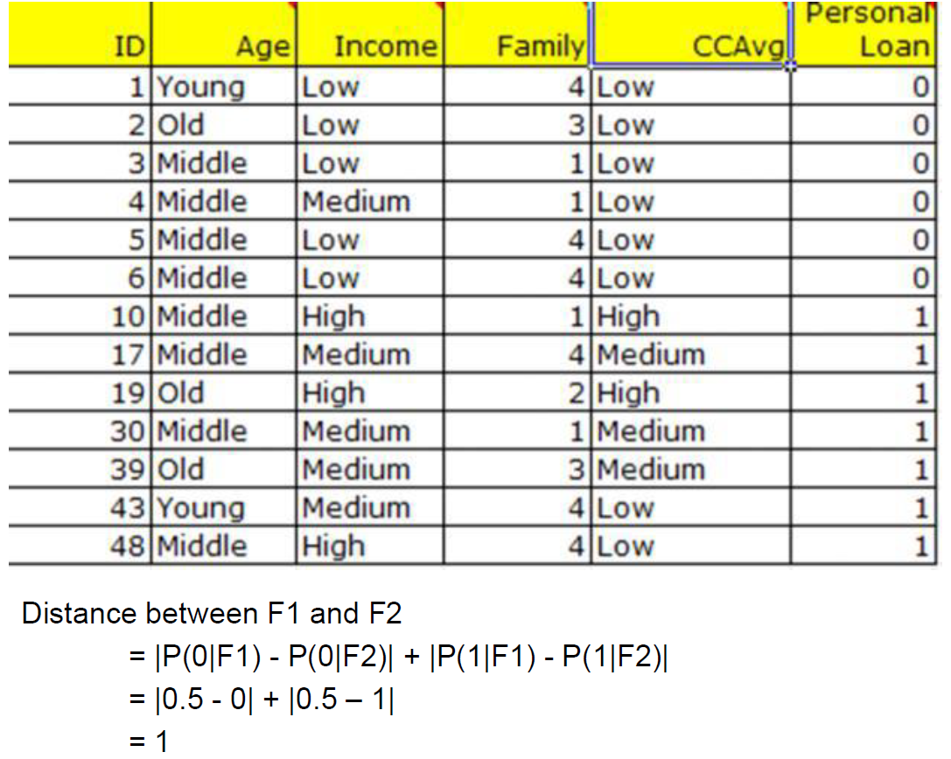

Slide 18
Ordinal Variables
Same as numeric
Look up is better than computation

Slide 19
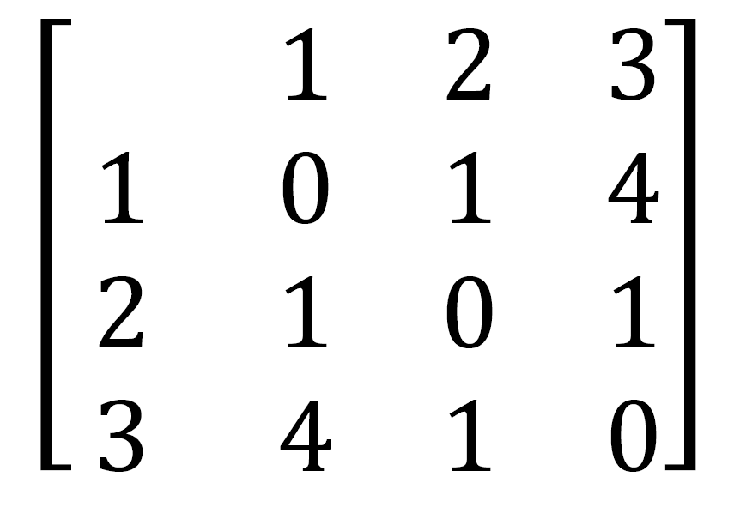
Look up matrix for ordinal with 3 states

Slide 20
CLUSTERING
UNSUPERVISED LEARNING

Slide 21
UNSUPERVISED LEARNING
Supervised : Data and target
Unsupervised : Just data

Slide 22
Clustering
One of the unsupervised learning techniques
Finding similarity groups in data, called clusters,
-Data instances that are similar to (near) each other are in the same cluster
-Data instances that are very different (far away) from each other fall in different clusters

Slide 23
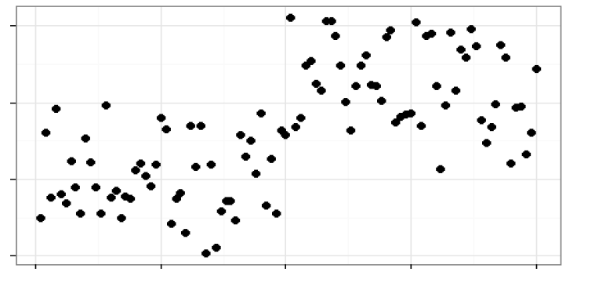
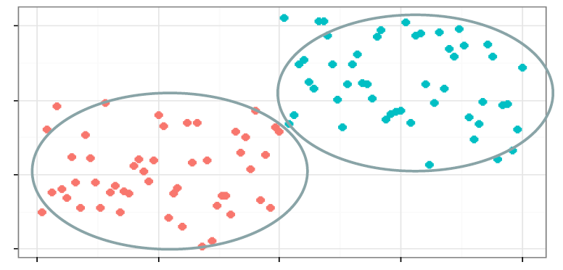

Slide 24
A few clustering applications
In marketing, segment customers according to their similarities
To do targeted marketing
It is not uncommon to have over 100,000 segments in insurance clustering

Slide 25
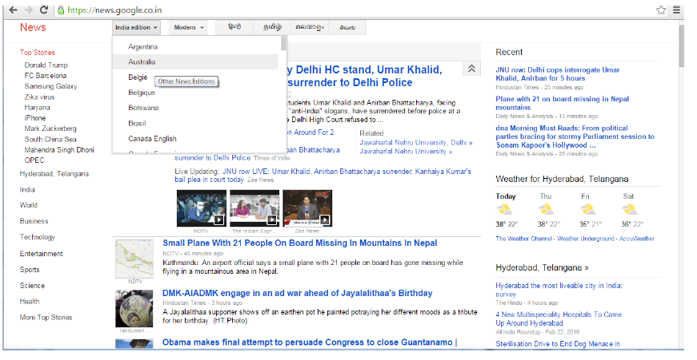
Google Search
Given a collection of text documents , organize them according to their content similarities
- e.g., Google News

Slide 26
Algorithms
Hierarchal approach : Create a hierarchical decomposition of the set of data (or objects) using some criterion(Wald)
Partitioning approach : Construct various partitions and then evaluate them by some criterion, e.g., minimizing the sum of square errors (K-mean, Spectral clustering)
Model based methods : A model is hypothesized for each of the clusters and tries to find the best fir of that model to each other (EM)

Slide 27
HIERARCHICAL CLUSTERING
AGGLOMERATIVE CLUSTERING

Slide 28
AGGLOMERATIVE CLUSTERING
Assign each item to its own cluster, so that if you have N items, you know have N clusters, each containing just one item
Merge most similar clusters into a single cluster, so that now you have one less cluster
Compute distances (similarities) between the new cluster and each of the old clusters
Repeat steps 2 and 3 until all items are clustered into a single cluster of size N

Slide 29
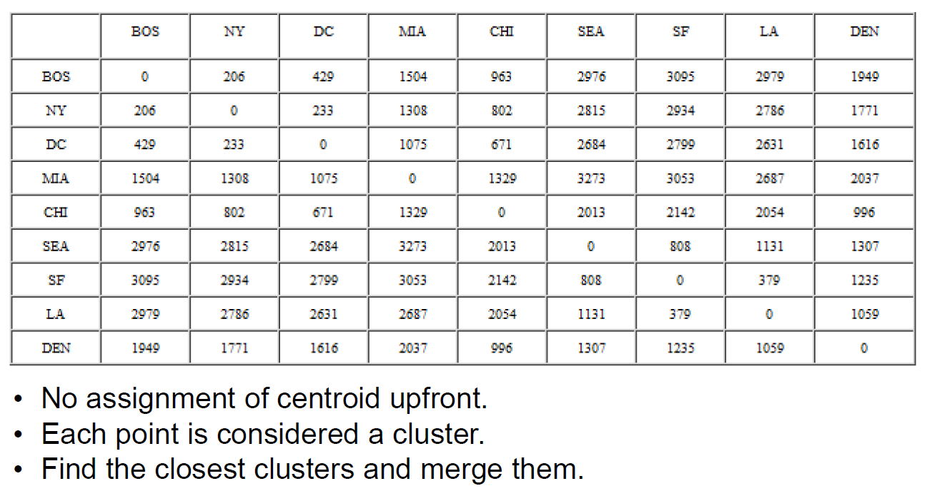
Example of agglomerative clustering

Slide 30
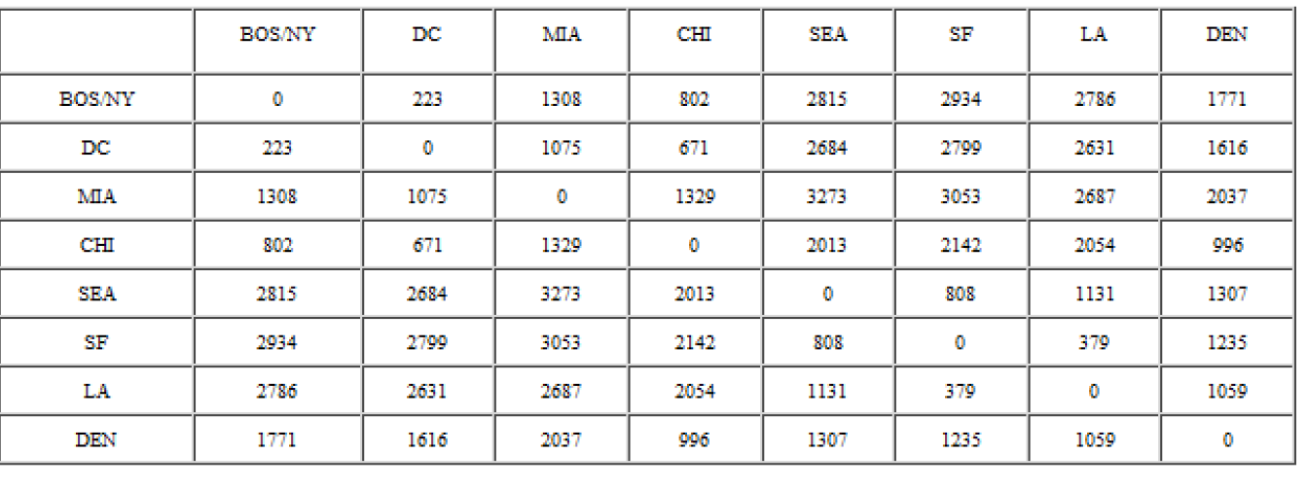

Slide 31
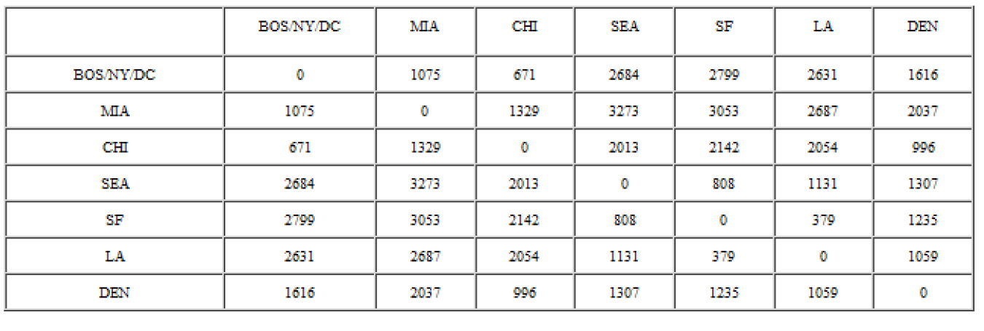

Slide 32
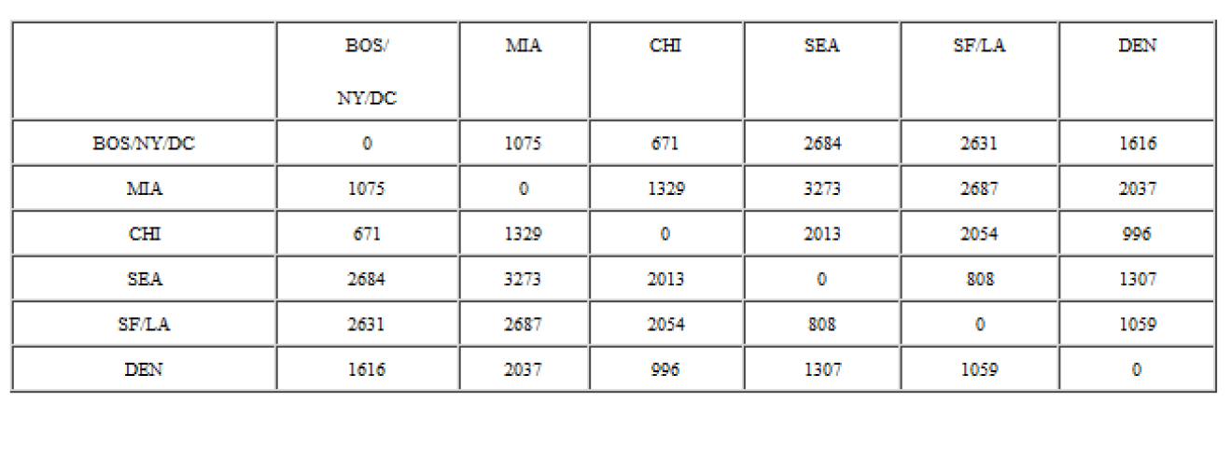

Slide 33
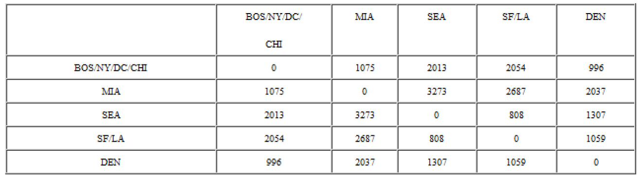

Slide 34
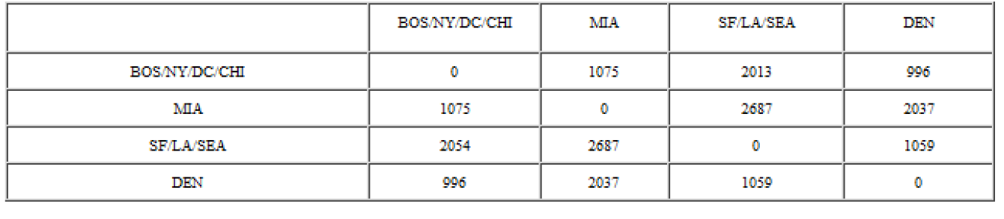

Slide 35
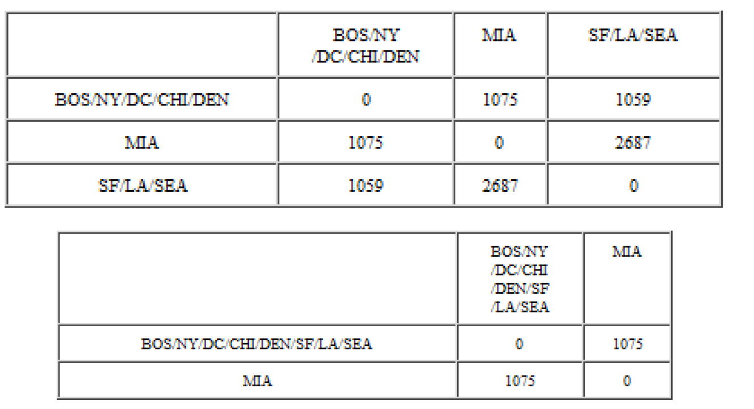

Slide 36
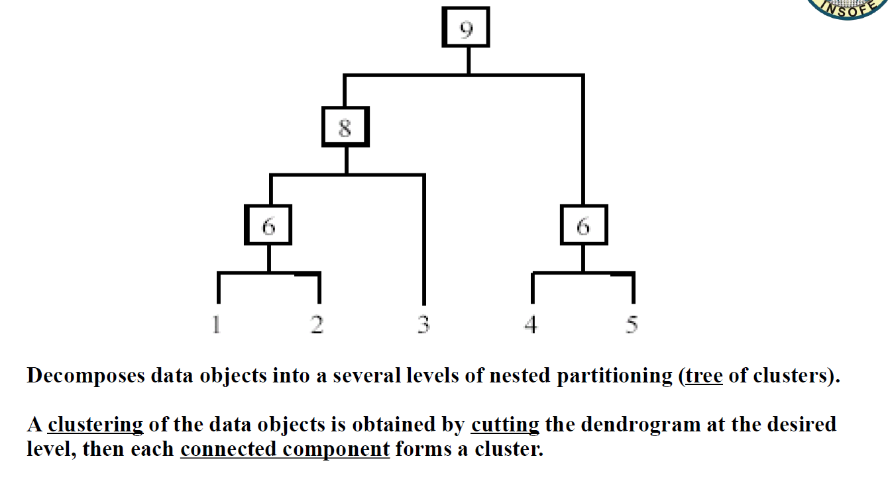
Hierarchical Clustering

Slide 37
Partitioning Algorithms
K-MEANS AND K-MEDOIDS

Slide 38
K-Means Clustering
K-Means is a partitional clustering algorithm as it partitions the given data into k clusters
Each cluster has a cluster center, called centroid
-k is specified by the user

Slide 39
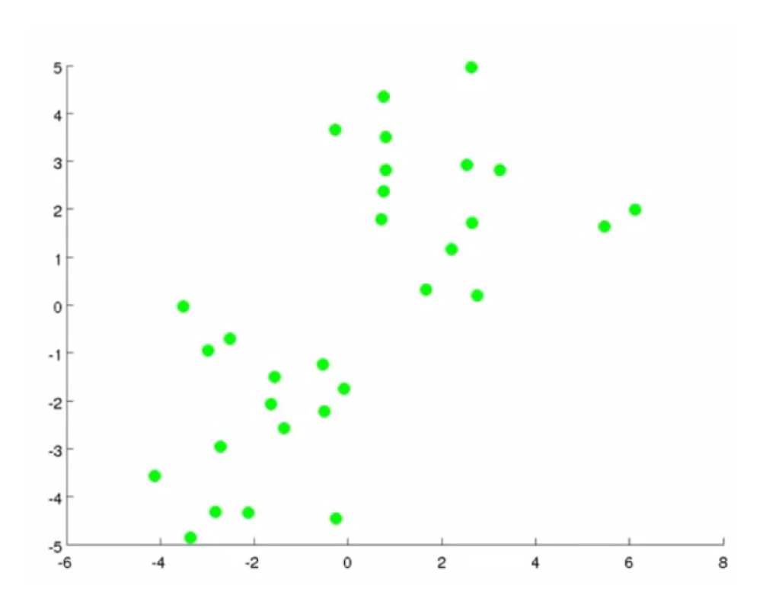
Picture Courtesy:
Andrew Ng, Coursera

Slide 40
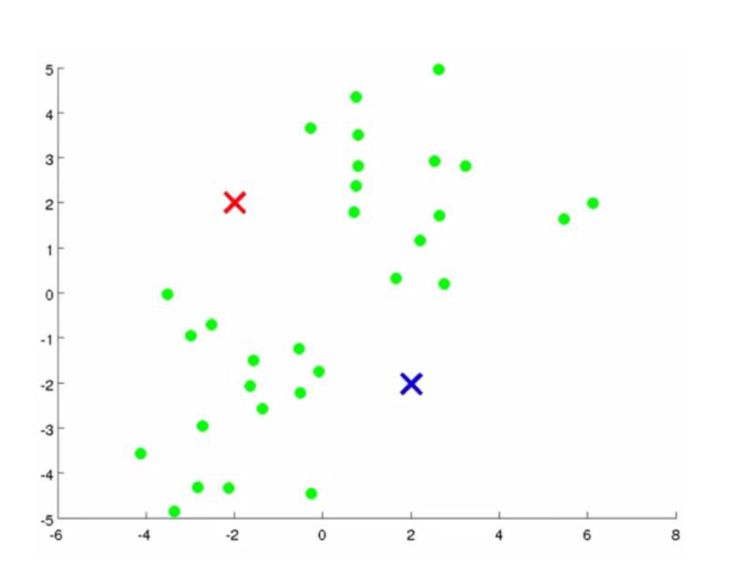

Slide 41
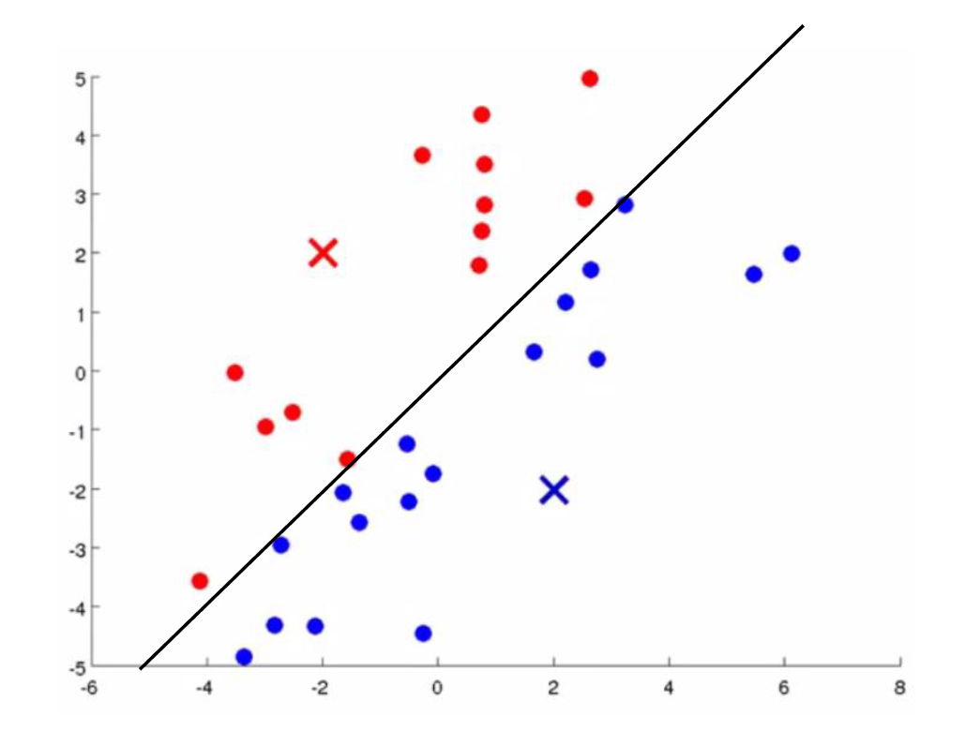

Slide 42
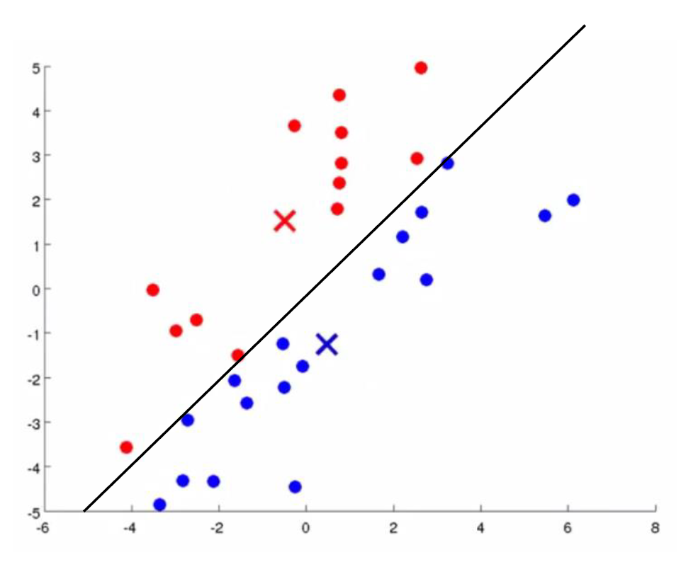

Slide 43
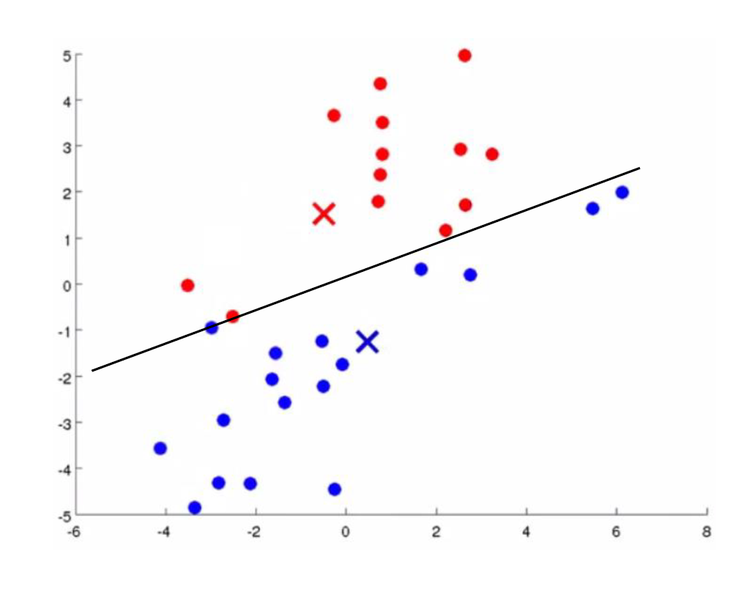

Slide 44
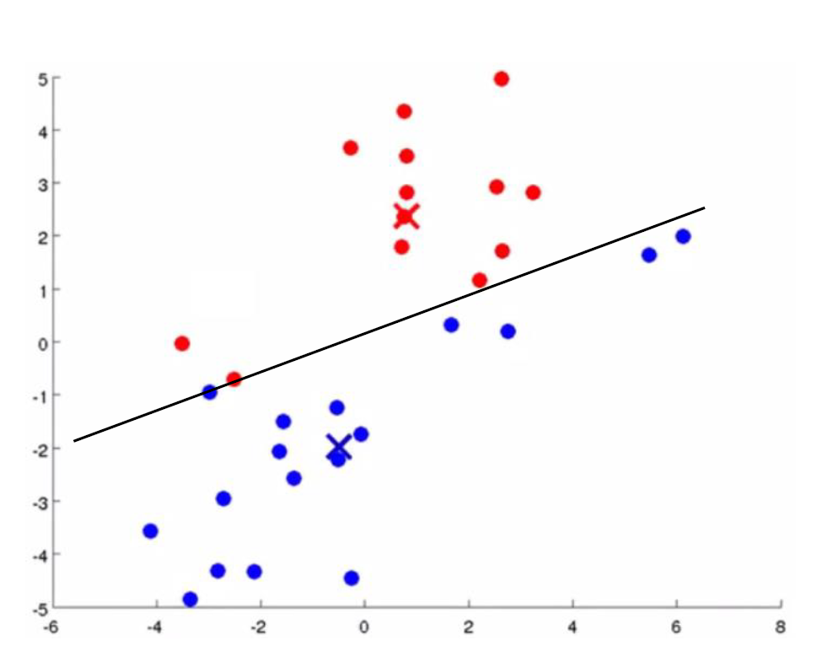

Slide 45
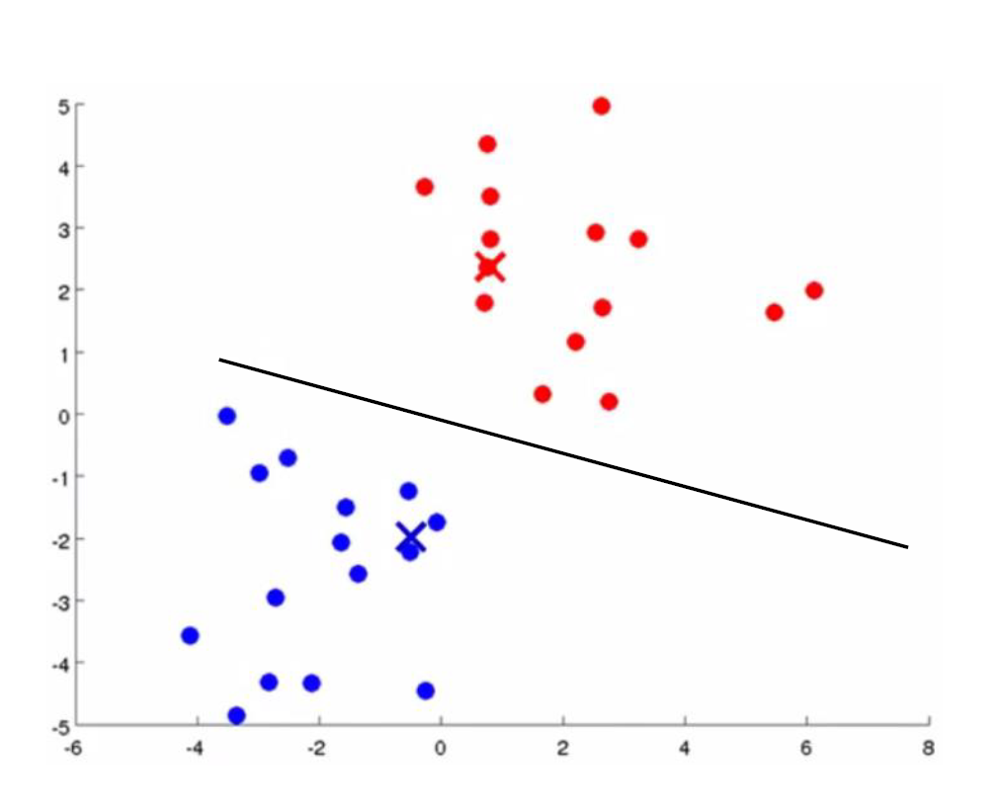

Slide 46
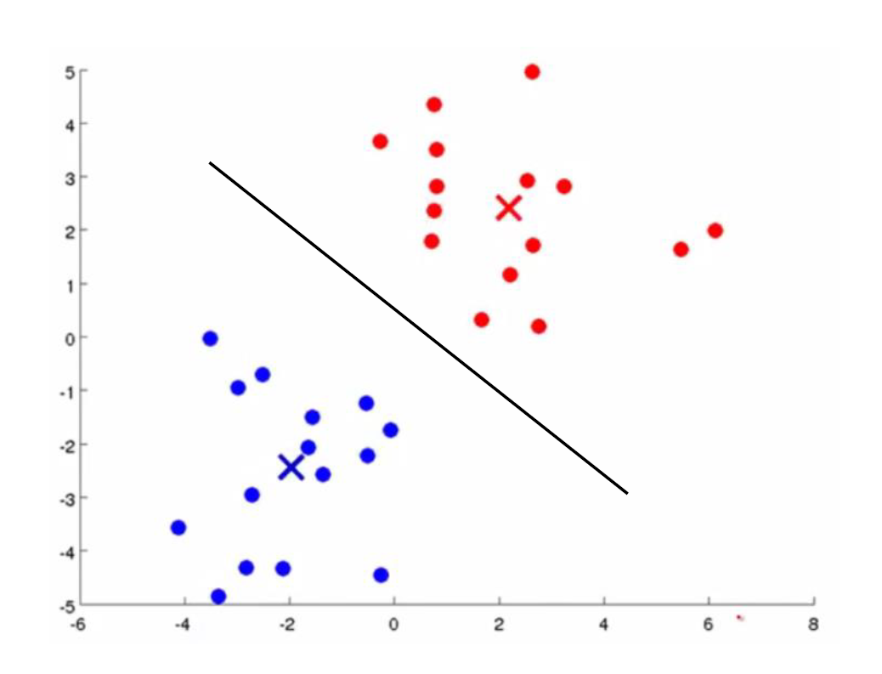

Slide 47
K-Means algorithm
Give k , the k-means algorithm works as follows:
Randomly choose k data points (seeds) to be the initial centroids, cluster center
Assign each data point to the closest centroid
Re-compute the centroids using the current cluster memberships
If a convergence criterion is not met, or if some clusters don’t get any points go to 2

Slide 48
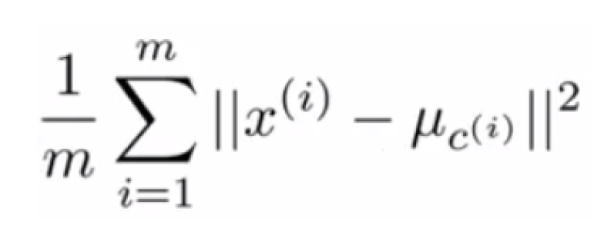
Optimizing

Slide 49
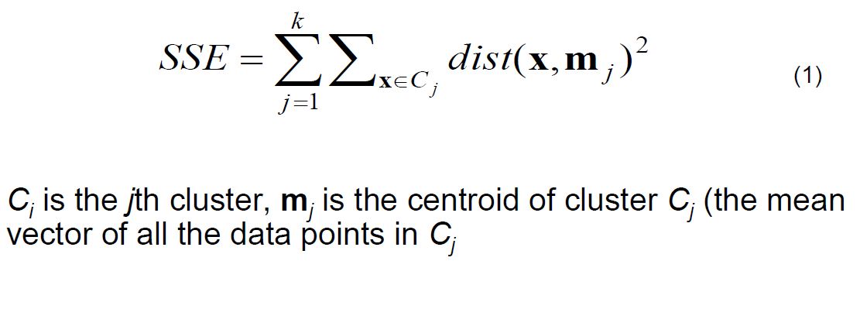
Stopping/Convergence criterion
No (or minimum) re-assignments of data points to different clusters
No (or minimum) change of centroids,or
Minimum decrease in the sum of squared error(SSE),

Slide 50
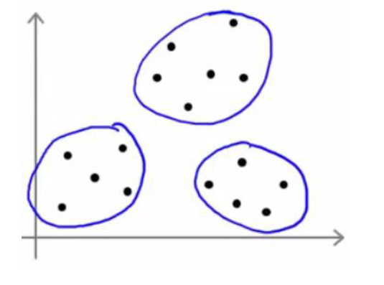
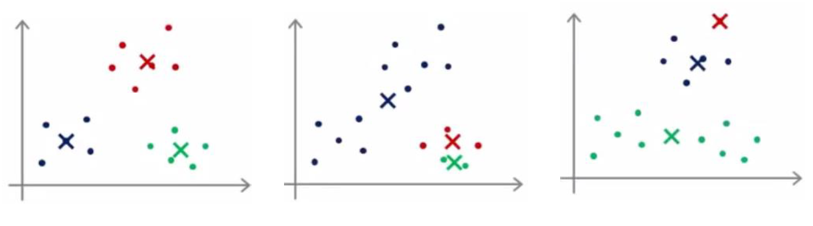
Local Optima

Slide 51
What is the problem with K-Means?
It is sensitive to outliers!
K-Medoids: Instead of taking the mean value of the object in a cluster as a reference point, medoids can be used, which is the most centrally located object in a cluster

Slide 52
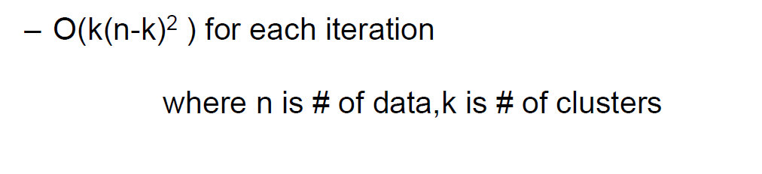
What is the problem with Medoids?
More robust than k-means in the presence of noise and outliers because a medoid is less influenced by outliers or other extreme values other than a mean
Works efficiently for small data sets but does not scale well for large datasets
-

Slide 53
How do we employ distance in a cluster?
Python code demo

Slide 54
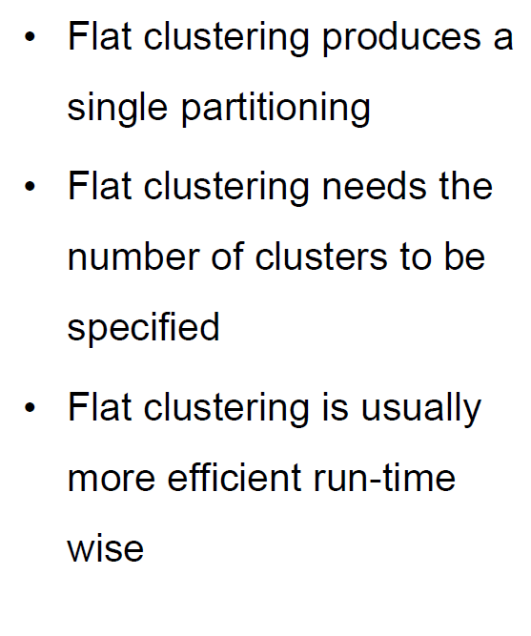
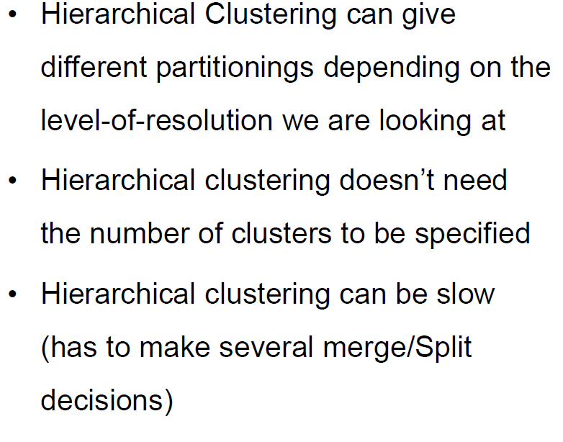
K-Means versus Hierarchical

Slide 55
Engineering

Slide 56
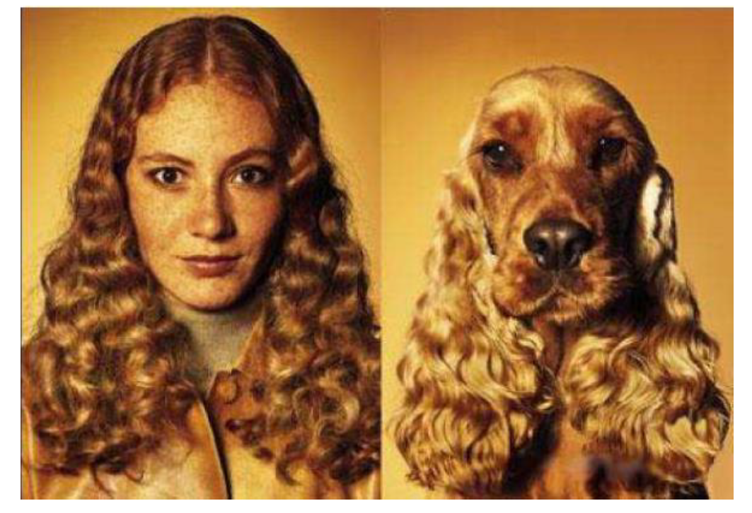

Slide 57
Stability check of the Clusters
To check the stability of the clusters take a random sample of 95% of records. Compute the clusters. If the clusters formed are very similar to the original, then the clusters are fine

Slide 58
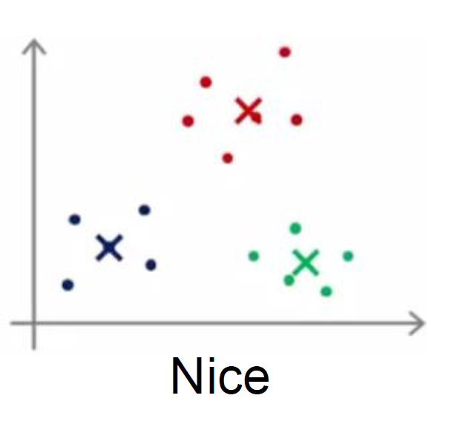
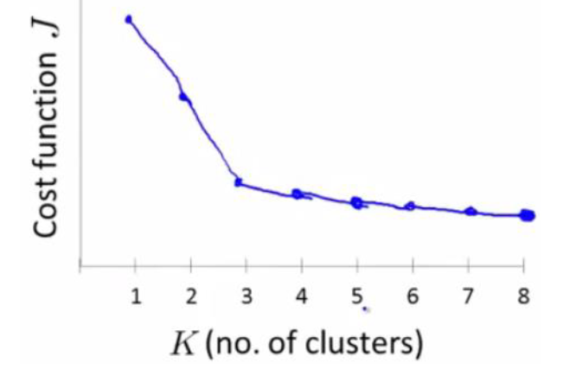
Linearly Clustered Data

Slide 59
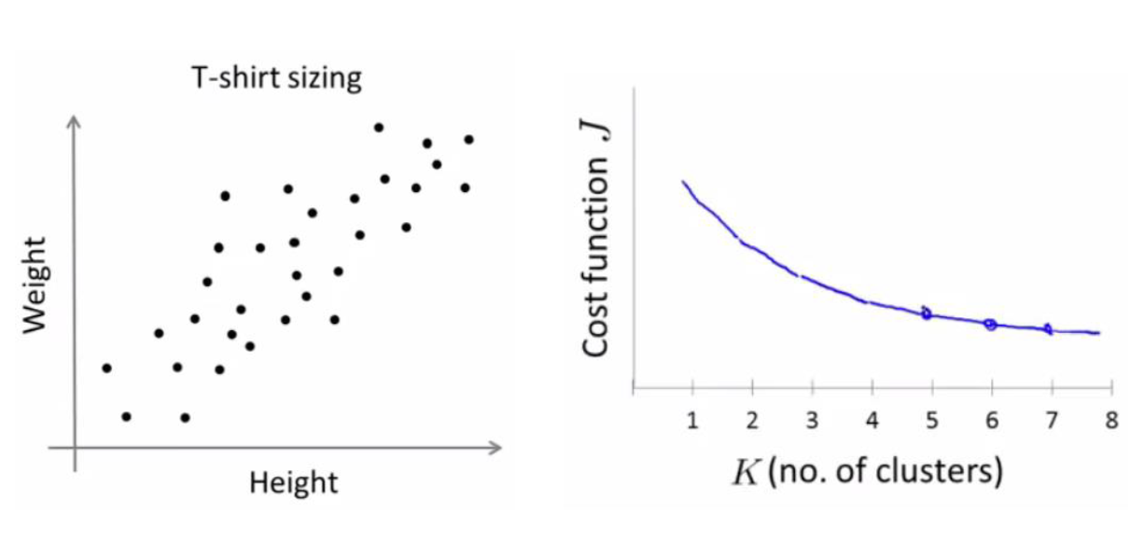
Linearly Separable but merged

Slide 60
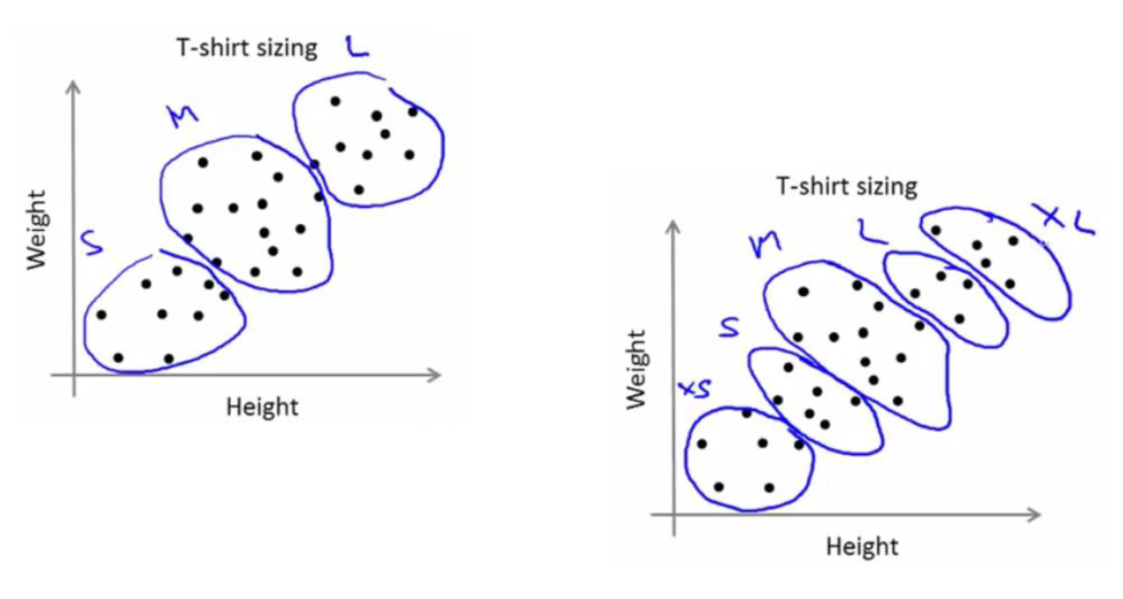

Slide 61
Linearly Separable
Run 50-500 simulations for small k (2-10). For large k (100 or so),we can do 1-5 simulations
Pick the one that gives the best S

Slide 62
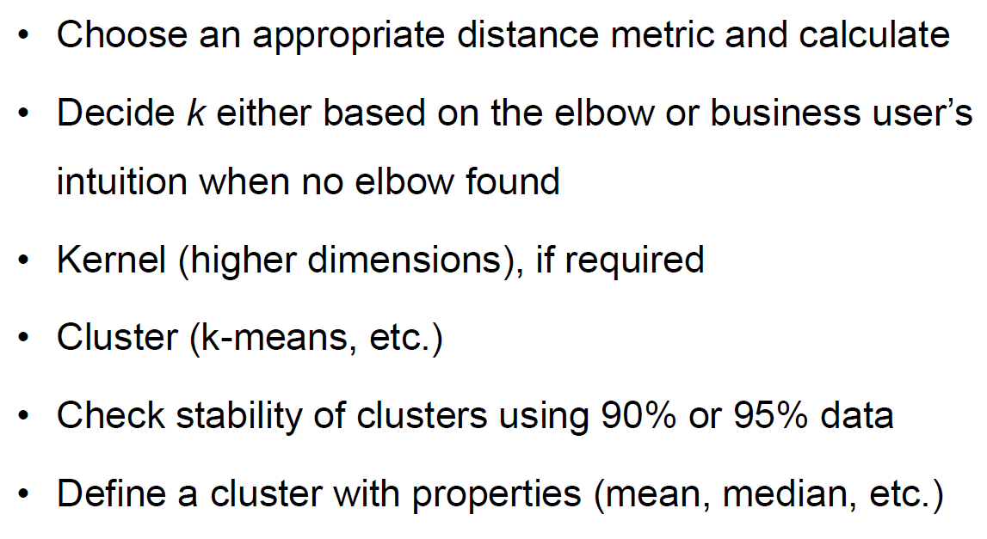
Clustering Process Summary

